Slide 1
BDD
Lesson – 8 : Selenium – Business readable UI automation with cucumber

Slide 2
Lesson Objectives
In this lesson, you will learn:
Business readable UI automation with cucumber
Notes:
Reference : https://www.cs.colorado.edu/~kena/classes/5828/s12/lectures/09-bddcucumber.pdf

Slide 3
Introduction
Cucumber does not communicate directly with the applications, it needs to be used in conjunction with tools such as Selenium WebDriver
Cucumber acts more like an execution framework.
Cucumber’s use of English-like language (Gherkin) for its programming function, test case execution is supported with features and scenarios executed based on their definitions.
Notes:
Reference : https://www.cigniti.com/blog/successful-test-automation-with-selenium-and-cucumber/

Slide 4
Business readable UI automation with cucumber
There are 3 steps for writing automated tests that deliver high value while requiring only low maintenance using Cucumber:
Step 1 : Define scenarios:
The acceptance tests are written in English-like language called Gherkin.
The scenarios defined are based on the user stories and features defined by the BA team.
Sometimes, the BA also creates the Feature files for use by the testing team.
Step 2: Create step definitions:
Once the scenarios are defined, the steps have to be implemented for execution.
This can be done in a variety of different languages supported by Cucumber.
For instance, if a language like Java is selected for implementation, the necessary classes and methods are defined by creating a project structure.
The project can have references added to the Selenium jars, so that the packages can be imported and used to implement the steps to drive browsers using Selenium API.
Step 3: Define UI Element descriptions:
One of the best ways to define UI element descriptions is using the PageObject design pattern.
PageObject pattern makes automated test maintenance easier.
This is because any changes made to the page elements are abstracted into the PageObjects itself, without the need to update feature files and step definitions.
Notes:
Reference : https://www.cigniti.com/blog/successful-test-automation-with-selenium-and-cucumber/

Slide 5
Business readable UI automation with cucumber
Write a test in a Feature File
Test to Automate
Ritika visits ToolsQA Demo Website for the first time and SEARCH for Dress. She selects the first product and goes to product page. She successfully adds it to the bag. She continues to Cart Page from mini cart icon at the top right corner. Then she moves forward to Checkout page. She choose to be an ANONYMOUS USER (Not Registering) completes email and address details. She selects FREE delivery, and places the order using CHECK payment method with Billing & Delivery address as same.
Cucumber BDD Style Test
Given user is on Home Page
When he search for “dress”
And choose to buy the first item
And moves to checkout from mini cart
And enter personal details on checkout page
And select same delivery address
And select payment method as “check” payment
And place the order
Notes:
Reference : https://www.cigniti.com/blog/successful-test-automation-with-selenium-and-cucumber/

Slide 6
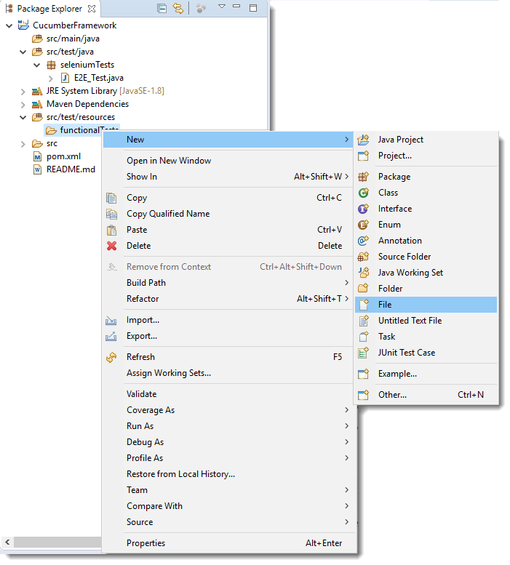
Business readable UI automation with cucumber
Create Feature File
1. Create a New Package and name it as functionalTests, by right click on the src/test/resources and select New >> Package. Note: It is always recommended to put all the feature files in the resources folder.
2. Create a Feature file and name it as End2End_Test.feature by right click on the above created package and select New >> File.
Notes:
Reference : http://toolsqa.com/selenium-cucumber-framework/convert-selenium-test-into-cucumber-bdd-style-test/

Slide 7
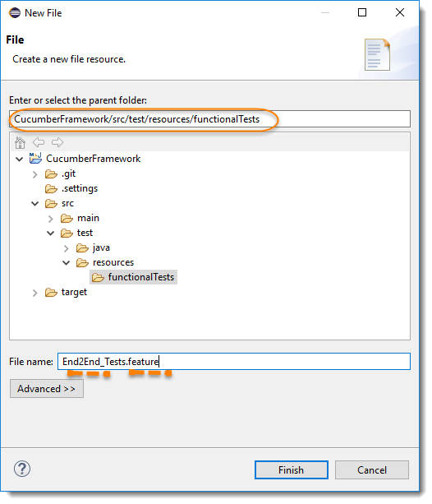
Business readable UI automation with cucumber
Create Feature File
Make sure to add .feature extension to the file.
Notes:
Reference : http://toolsqa.com/selenium-cucumber-framework/convert-selenium-test-into-cucumber-bdd-style-test/

Slide 8
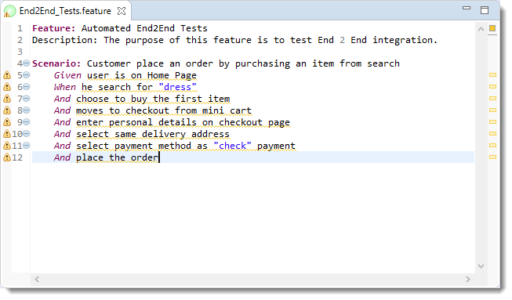
Business readable UI automation with cucumber
Create Feature File
Add the test steps to the feature file.
Notes:
Note: Notices that all the keywords used in the test steps are in different colors. These are Gherkin keywords. By default Eclipse does not understand these but if you install the cucumber Eclipse plugin-in, this will be recognized.

Slide 9
Business readable UI automation with cucumber
Create a JUnit Test Runner
1. Create a New Package and name it as runners by right clickon the src/test/java and select New >> Package.
2. Create a New Java Class file and name it as TestRunner by right click on the above created package and select New >> Class.
package runners;
import org.junit.runner.RunWith;
import cucumber.api.CucumberOptions;
import cucumber.api.junit.Cucumber;
@RunWith(Cucumber.class)
@CucumberOptions(
features = "src/test/resources/functionalTests"
)
public class TestRunner {
}
Notes:
Note: Make sure not to click on the public static void main.

Slide 10
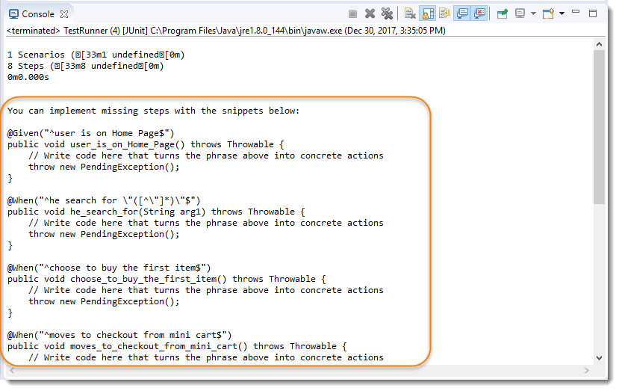
Business readable UI automation with cucumber
Write test code to Step file
1) To get the steps automatically generated, we need to execute TestRunner class. Right click on the TestRunner file and select Run As >> JUnit Test. You would get the below result in the Eclipse Console.
Notes:
Note: Make sure not to click on the public static void main.

Slide 11
Business readable UI automation with cucumber
Write test code to Step file
2) Create a New Package and name it as stepDefinitions by right click on the src/test/java and select New >> Package.
3) Create a New Java Class and name it is as Steps by right click on the above created package and select New >> Class.
4) Now copy all the steps created by Eclipse to this Steps file and start filling up these steps with Selenium Code. Take all the code from our Selenium Test file created in the End2End_Test. Steps test file will look like this:
Notes:
Note: Make sure not to click on the public static void main.

Slide 12
Business readable UI automation with cucumber
Write test code to Step file
5) We also need to make sure that the TestRunner file would also able to find the steps files.To achieve that we need to mention the path of the package, where we have kept all of our step definitions in CucumberOptions.
package runners;
import org.junit.runner.RunWith;
import cucumber.api.CucumberOptions;
import cucumber.api.junit.Cucumber;
@RunWith(Cucumber.class)
@CucumberOptions(
features = "src/test/resources/functionalTests",
glue= {"stepDefinitions"}
)
public class TestRunner {
}
Notes:
Note: By default Junit/Cucumber finds the test code in the src/test/java folder, this is why we just need to specify the package name for the cucumber glue.

Slide 13
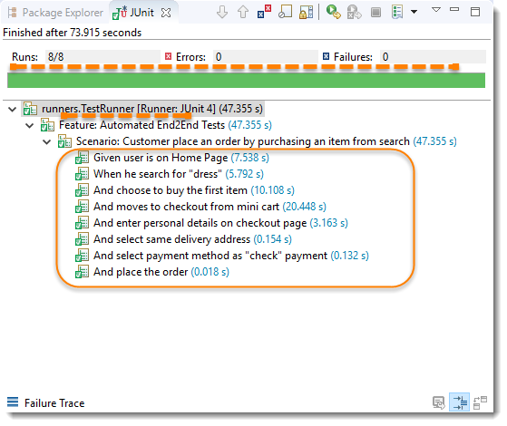
Business readable UI automation with cucumber
Run the Cucumber Test
Run as JUnit
Now we are all set to run the first Cucumber test. Right Click on TestRunner class and Click Run As >> JUnit Test.
Cucumber will run the script the same way it runs in Selenium WebDriver and the result will be shown in the left hand side project explorer window in JUnit tab.
Notes:
Note: By default Junit/Cucumber finds the test code in the src/test/java folder, this is why we just need to specify the package name for the cucumber glue.

Slide 14
Summary
In this lesson, you have learnt :
Business readable UI automation with cucumber

